Slide 1
Remote controlled car
Digilent Digital Contest
By : Serban Cordis & Lucian Palcu
Instructor: Prof. Dr. Ing. Mircea Dabacan
Technical University Cluj-Napoca

Slide 2
Summary
Objectives
Introduction
Serial transmission
Stepper Motors
The Design
Design tools used
Conclusion

Slide 3
Objectives
  To demonstrate some of the the multiple uses of Cerebot board :
  - RS232 serial communication
  - stepper motors commmand
  - external interrupts handling
  - timer controlled program flow

Slide 4
Introduction
In order to demonstrate the Cerebot board’s capabilities we designed a remote controlled toy car

Slide 5
Introduction
The car has to perform the following tasks:
  move forward/backward continously or for a certain number of steps
  start/stop one of the motors
  modify the motors’ stepping rate
  change the step mode
  automatically change the cruise direction after a colision
  enable/disable colision detection
  turn left/right

Slide 6
Serial Communication
Used to send computer serial signals to Cerebot Board
based on the Digilent’s RS232 converter module
the UART units built in the Atmega64 controller are responsible for handling the incomming transmissions

Slide 7
Stepper Motors
electromechanical devices which converts electrical pulses into discrete mechanical movements
discrete step increments when proper sequence applied
the rotation has direct relationships to applied input pulses
    the spin direction depends on applied sequence
    the rotation speed depends on the frequency of applied pulse
provides movement and steering to the car

Slide 8
The Design
The entire project is based on the Digilent’s Cerebot
    motor control
    establish serial communication with PC
    handling external interrupts

Slide 9
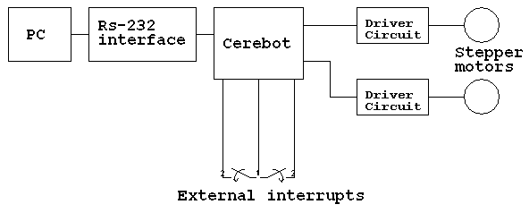
The Design

Slide 10
The Design – Motors Control
two driver board used for commanding the motors
the driver boards are connected to Cerebot’s connectors JA and JB which contain the pins 7, 6, 4, 5 of port D, 4 and 7, 6, 5, 4 of port B.
The step sequence is stored in an array of 8 bit values that are applied to the four most significant bits of ports B and D.
A mask is be used when sending the sequence out the ports

Slide 11
The Design - External Interrupts
Used for collision detection
    When colliding with something a push-to-make switch send a signal to the controller through Digilent’s digital input module board
    A external interrupt is generated and its associated code is executed

Slide 12
The Design – Transmission system
The spinning from the stepper motors is transmitted to the wheels with the mechanism shown in the following picture

Slide 13
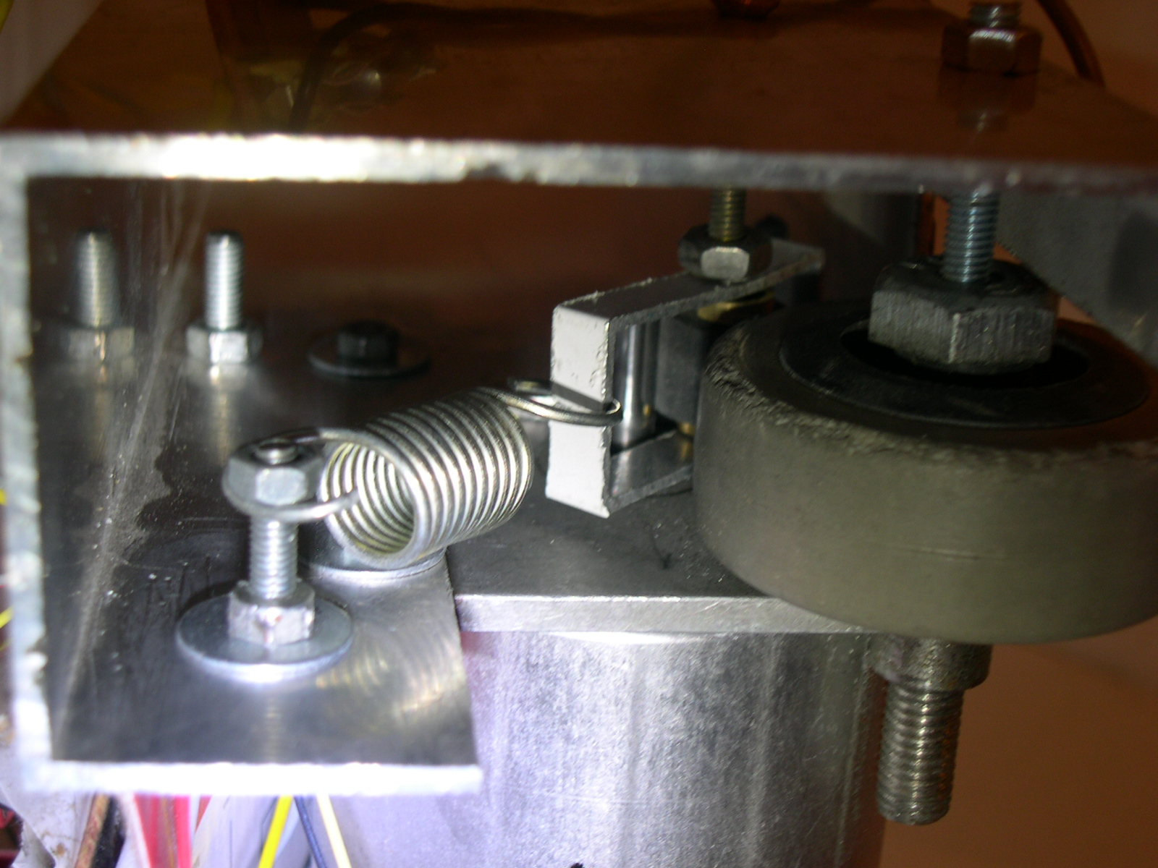
The Design – Transmission system

Slide 14
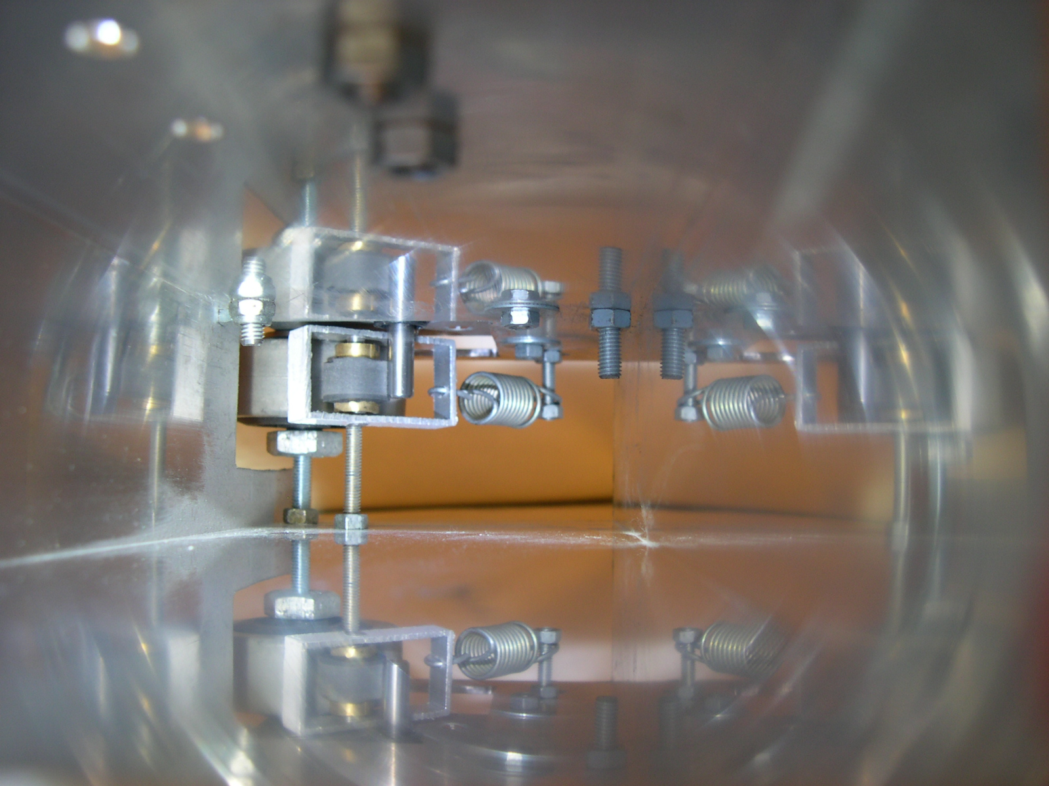

Slide 15
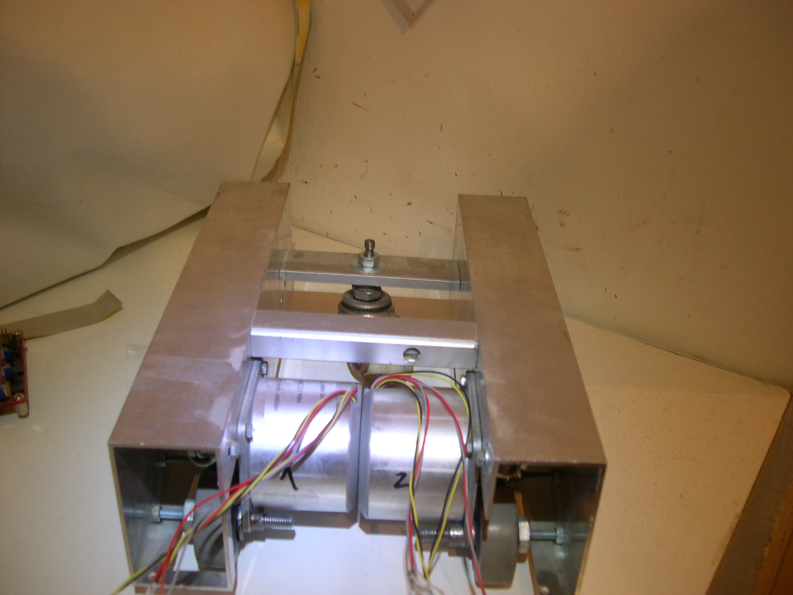
The Design - Chassis

Slide 16
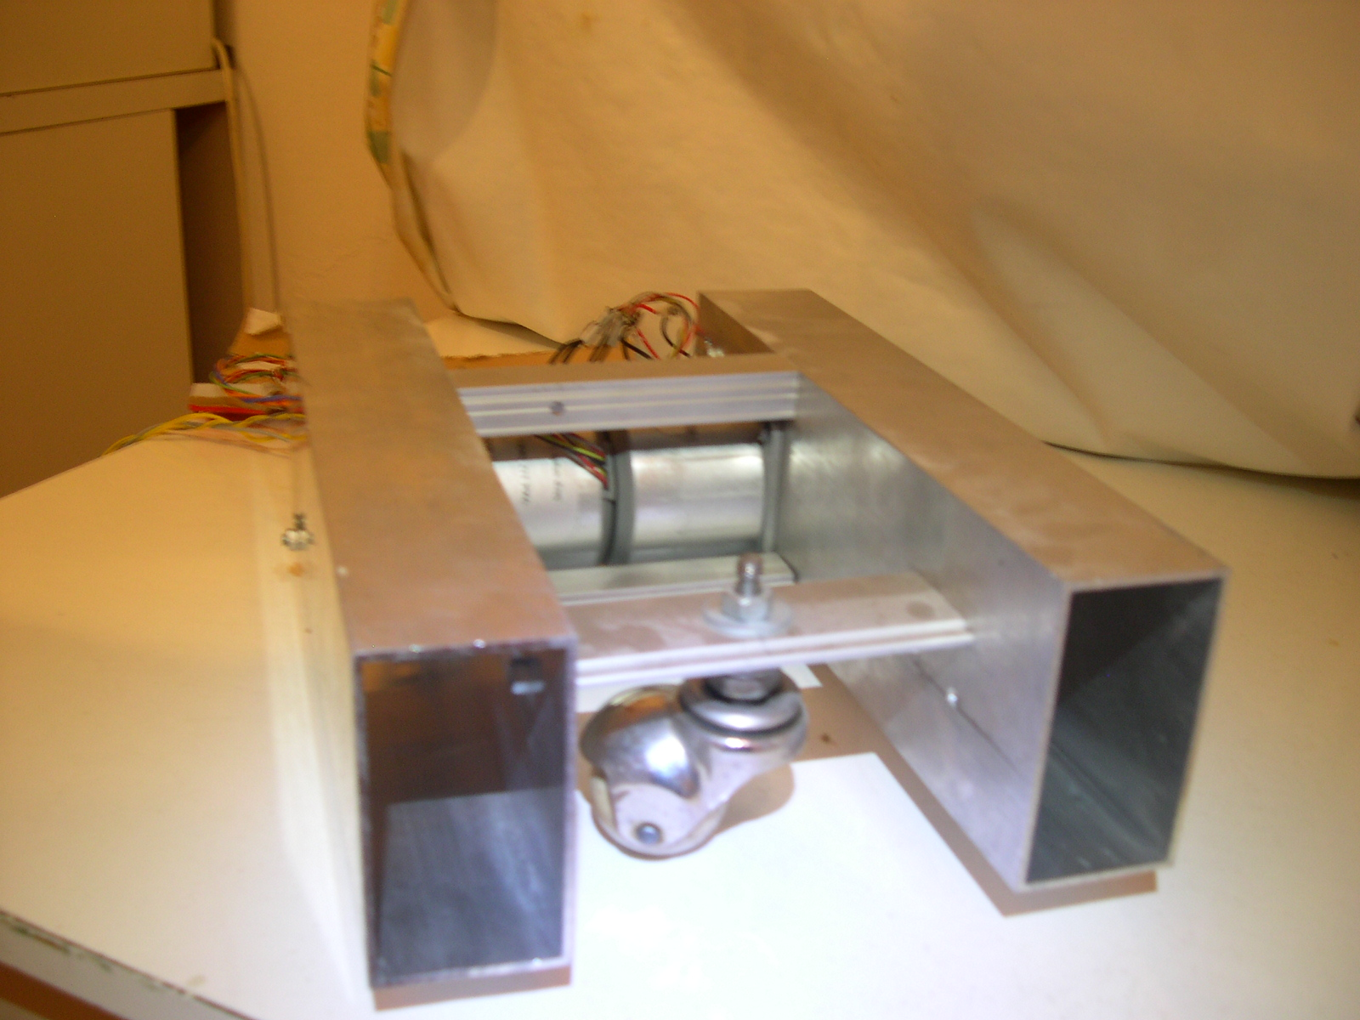
The Design - Chassis

Slide 17
Design tools used
CVAVR -source code editing and compiling
-serial communication
Digilent’s AVR programmer – loading the binary code into the Cerebot’s program memory
Orcad Schematic Capture, PSpice and Layout: editing/simulating and designing the layout for the motor driver board

Slide 18
Possible developments
the program requires minimal modifications to accommodate Digilent’s H-bridges
making the car completely independent:
  a battery must be provided for motor power supply
  a wireless interface for the communication protocol must be implemented

Slide 19
Conclusions
Working on the project made us:
familiarize with some of Digilent’s products
to gain experience in microcontroller programming and digital designs

